Slide 1


EXAMINE THE MICROSTRUCTURE OF PLA7NF
FOR 3D PRINTNG FILAMENT
By
Project Members
ABINATH E (211419114005)
AKASH (211419114021)
BADRINARAYAN G (211419114045)
BALAJI B (211419114046)
Batch No: 03
Under the Supervision
Of
MR.P.SRIRAM M.E.
Assistant Professor
Department of Mechanical Engineering,
Panimalar Engineering College.

Slide 2
ABSTRACT
Many components were manufactured using traditional machining techniques in ancient times.
The quantity of wasted materials, labour hours, machining expenses, and machining times is significant when producing multiple complex pieces.
Today's industries have created a number of strategies for optimising the machining process with a zero PPM standard.
Rapid prototyping with 3D printing is one of the fastest techniques to efficiently reduce down on both waste and machining time in these emerging industries.
Multiple parts or components have been produced utilising 3D printing and certain materials

Slide 3
INTRODUCTION
A method of manufacturing known as ‘Additive manufacturing’, due to the fact that instead of removing material to create a part, the process adds material in successive patterns to create the desired shape. Main areas of use.
Prototyping Specialized parts – aerospace, military, biomedical engineering, dental Hobbies and home use Future applications– medical (body parts), buildings and cars 3D Printing uses software that slices the 3D model into layers (0.01mm thick or less in most cases).
Each layer is then traced onto the build plate by the printer, once the pattern is completed, the build plate is lowered and the next layer is added on top of the previous one.

Slide 4
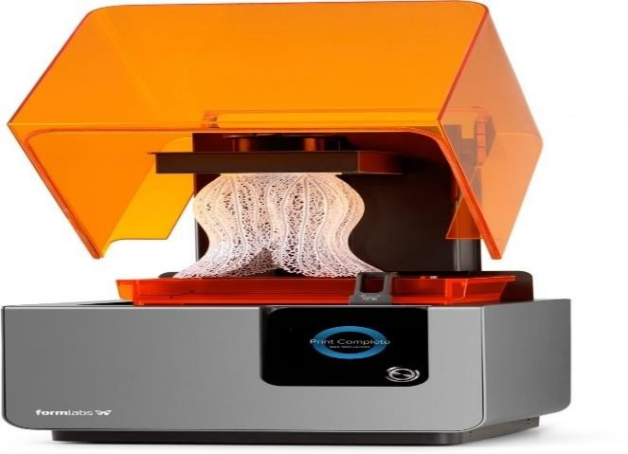
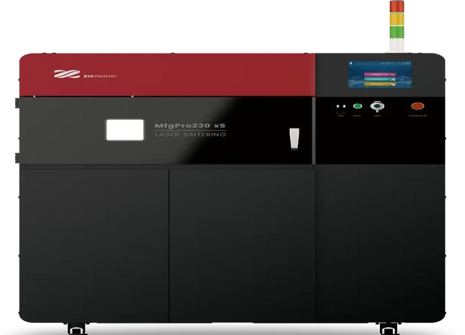
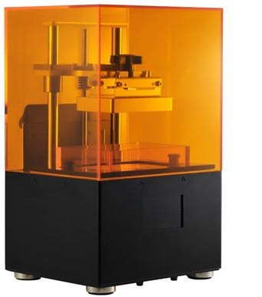
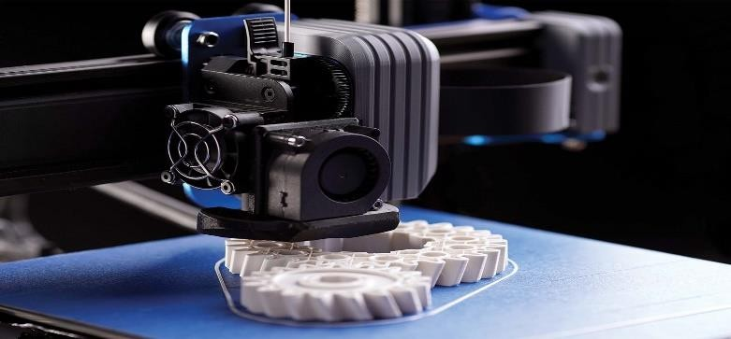
TYPES OF 3D PRINTERS
STEREOLITHOGRAPHY (SLA)
SELECTIVE LASER SINTERING (SLS)
Figure 1.1 Machine of Stereolithography (SLA)
Figure 1.2 Laser Sintering Machin(SLS)
FUSED DEPOSITION MODELING (FDM)
DIGITAL LIGHT PROCESS (DLP)
Figure 1.3 Fused Deposition Modelling Machine
Figure 1.4 Digital Light Process Machine

Slide 5
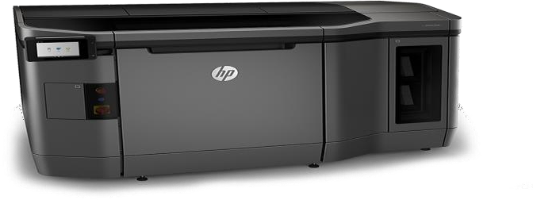
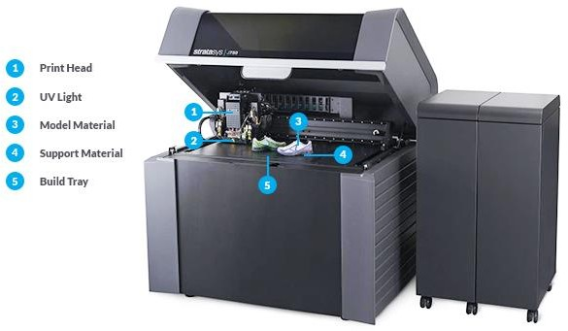
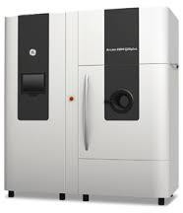
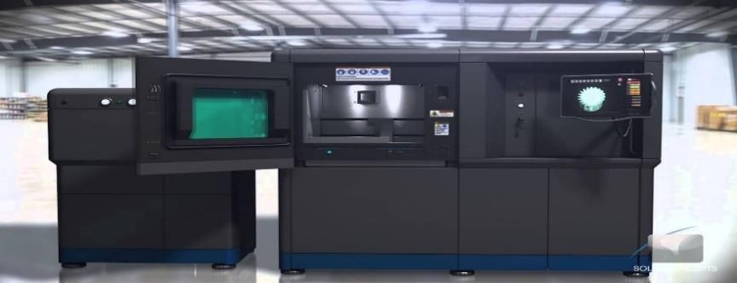
MULTI JET FUSION (MJF)
POLYJET
Figure 1.5 Multi Jet Fusion Machine
Figure 1.6 PloyJet Fusion Machine
DIRECT METAL LASER SINTERING (DMLS)
ELECTRON BEAM (EBM)
Figure 1.7 Direct Metal Laser Sintering Machine (DMLS)
Figure 1.8 Electron Beam Melting Machine (EBM)

Slide 6
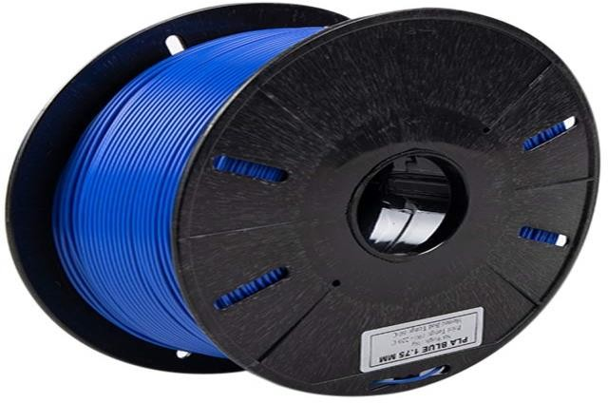
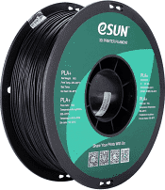
TYPES OF FILAMENT
ABS FILAMENT
PLA FILAMENT
Figure 1.9 Acrylonitrile Butadiene Styrene Filament Roller (ABS)
Figure 1.10 Polylactic acid Filament Roller (PLA)
A durable, strong 3D filament
Quite flexible and lightweight
Cheapest thermoplastic available at the time of writing
Most favored material among professional 3D printers and keen armatures
No harmful fumes, produces a sweet aroma when heated
Easier to work with compared to ABS
Compared to ABS, PLA is less prone to warping
Available in special effects like glow-in-the-dark colors and translucency

Slide 7
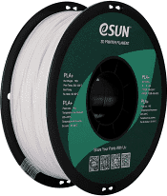
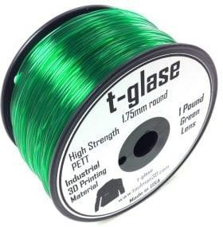
PET FILAMENT
PETT FILAMENT
Figure 1.11 Polyethylene Terephthalate Filament Roller (PET)
Figure 1.12 Polyethylene coTrimethylene Terephthalate Filament Roller
Strong, flexible, and with bio compatibility
Does not warp
Does not shrink
Does not absorb moisture from the air
Does not degrade in water
Strength, flexibility, and biocompatibility. Not brittle nor prone to
wrap
Does not shrink, can be printed on glass without any glues
Do not absorb water or moisture from the air, does not degrade in
water
FDA approved and impressive in bridging
Prices for PETT are also coming down with some as cheap as ABS

Slide 8
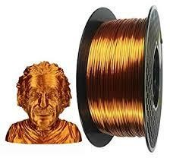
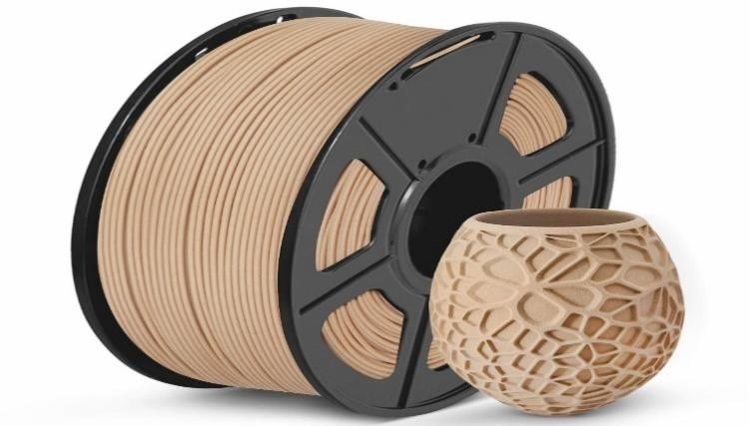
WOOD FILAMENT
METAL FILAMENT
1.13 Wood Filament Roller
Figure1.14 Metal Filament Roller
Contain real wood fibers
Produce different shades of brown wooden-like surfaces
The higher the temperature the darker brown shade
Changing printing temperature stimulates tree’s growth ring effect
You decorate and post-process, like cut, grind and paint
Highly durable
Not soluble
Very little shrinkage during cooling

Slide 9
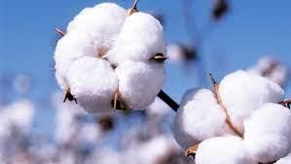
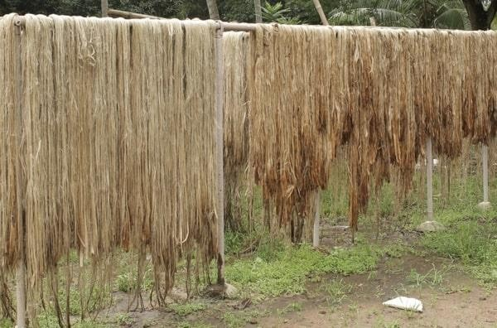
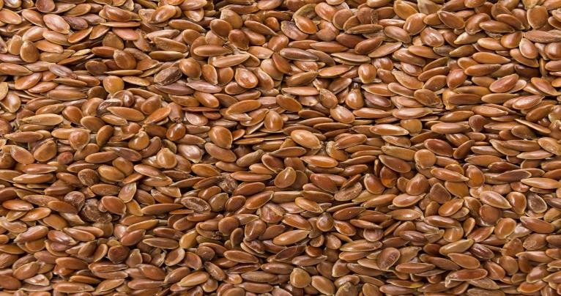
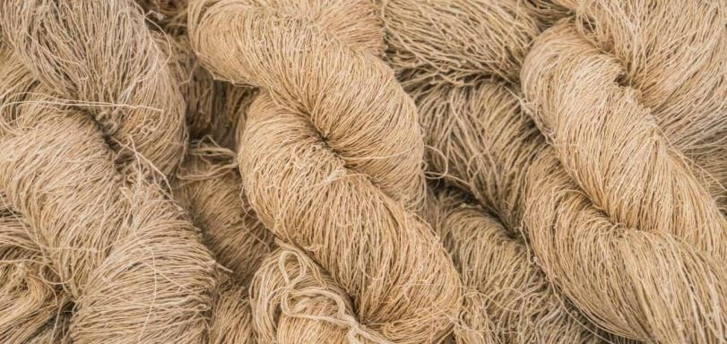
TYPES OF FIBRE
NATURAL FIBRE
COTTON
JUTE
Figure 1.15 Plant Fibre of Cotton
Figure 1.16 Plant Fibre of Jute
FLAX
HEMP
1.17Plant Fibre of Flax
1.18 Plant Fibre of Hemp

Slide 10
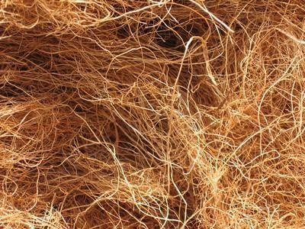
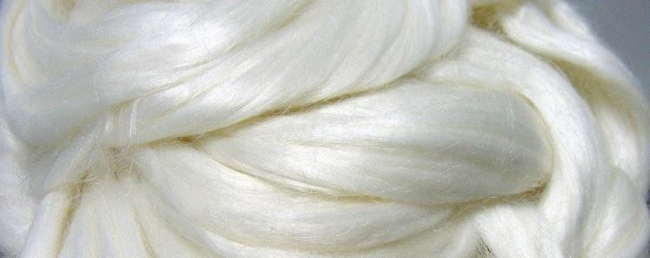
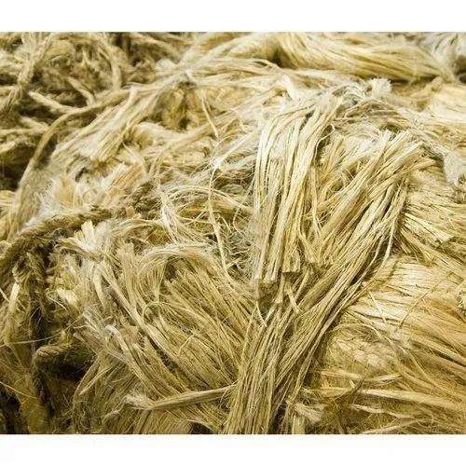
COIR
RAIME
1.19Plant Fibre of Coir
1.20 Plant Fibre of Raime
KENAF
1.21 Plant Fibre of Kenaf

Slide 11
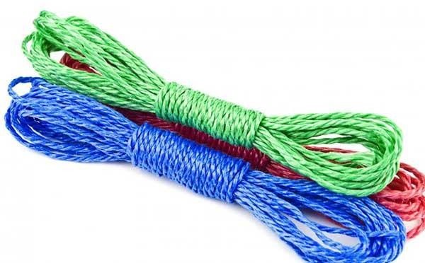
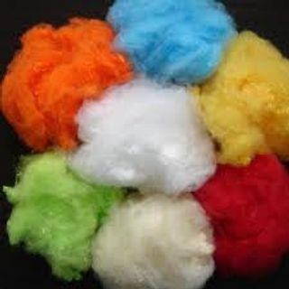
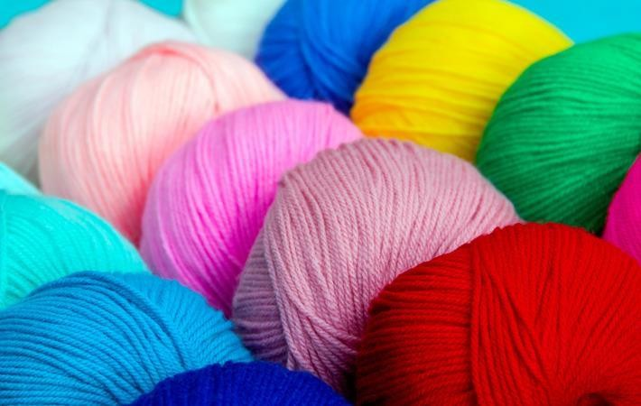
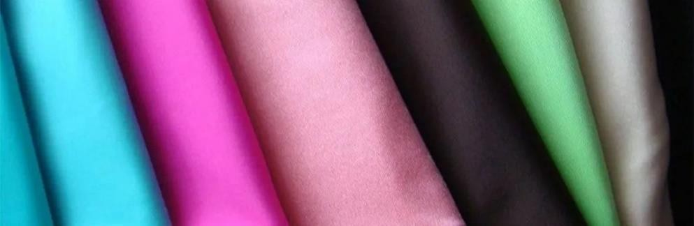
SYNTHETIC FIBRE
NYLON
POLYESTER
1.22 Nylon Fibre
1.23 Polyester
ARCYLIC
SPANDEX
1.24 Arcylic
1.25 spandex

Slide 12
LITERATURE SURVEY
Sl. No. | Title of the Paper/Author /Year | Journal Name | Interference | Remarks
1 | 3D Printing of Fiber-Reinforced Plastic Composites Using Fused Deposition Modeling/Salman Pervaiz/2021 | Additive Manufacturing | FRP materials are widely used in structural applications related to defense, automotive, aerospace, and sports-based industries | The available literature on FRP composites is focused only on describing the properties of the product and the potential applications for it
2 | 3D Printing of Fibre-Reinforced Thermoplastic Composites Using Fused Filament Fabrication/Andrew N Dickson/2020 | Additive Manufacturing | Three-dimensional (3D) printing has been successfully applied for the fabrication of polymer components ranging from prototypes to final products | The addition of fibres and other materials into the polymer matrix to form a composite can yield a significant enhancement in the structural strength of printed polymer parts.
3 | Polymer Matrix Composite in 3D Printing | Additive Manufacturing | an endeavour has been made to recognize the different Polymer Matrix Composite (PMC) materials used for the 3D printing through an extensive literature survey | researchers have primarily focussed on development of in-house Polymer Matrix Composite materials using variable composition, size and type of reinforcements and matrix

Slide 13
Sl. No. | Title of the Paper/Author /Year | Journal Name | Interference | Remarks
4 | Applications of 3D-Printed PEEK via Fused Filament Fabrication/Rupak Dua/2021 | Additive Manufacturing | Polyether ether ketone (PEEK) is an organic polymer that has excellent mechanical, chemical properties and can be additively manufactured (3D-printed) with ease. The use of 3D-printed PEEK has been growing in many fields. | it was concluded that PEEK is a versatile material, and 3D-printed PEEK is finding applications in numerous industries. However, most of the applications are still in the research phase
5 | 3D-Printed Carbon Fiber Reinforced Polymer Composites/Seyed Hamid Reza Sanei/2020 | Additive Manufacturing | Fiber reinforced composites offer exceptional directional mechanical properties, and combining their advantages with the capability of 3D printing has resulted in many innovative research fronts | Due to the unique advantages of 3D printing, in addition to conventional unidirectional fiber orientation, concentric fiber rings have been used to optimize the mechanical performance of a part
6 | Filament processing, materials, and printing parameters/Ruban Bayu Kristiawan/2021 | Additive manufacturing | The effects of each parameter, and their interaction with other parameters. The study started from the filament manufacturing process, filament material types, and printing parameters of FDM techniques. | This study also identifies several vital areas of previous and future research to optimize and characterize the critical parameters of the FDM printing process and FDM filament manufacturing.

Slide 14
Sl. No. | Title of the Paper/Author /Year | Journal Name | Interference | Remarks
7 | 3D Printing of complex structures: Case study of Eiffel Tower/R.Surya Teja/2022 | Additive Manufacturing | The primary objective of this research is to comprehend the process of 3D printing for complex structures. “This article provides a concise overview of the available 3D printing methods and technologies, along with their industrial applications | The generic process chain of 3D printing, from the initial stage of CAD modelling, to the production of the final part with a typical example of an Eiffel tower is demonstrated.
8 | Structural Analysis of Carbon Fiber 3D-Printed Ribs for Small Wind Turbine Blades/Victor A/2022 | Additive Manufacturing | The ribs were manufactured according to NACA 23015 and NACA 633618 geometries, with polylactic acid (PLA) and polylactic acid with carbon fiber additives (CF-PLA) | 3D-printed built-in holes provided higher compression strength, hence higher structural efficiency, than the drilled samples. Significant improvement by adding carbon fiber additives into the PLA resin system in comparison to raw PLA was detected for at least one of the studied airfoil profiles

Slide 15
Sl. No. | Title of the Paper/Author /Year | Journal Name | Interference | Remarks
9 | Optimization strategies and emerging application of functionalized 3D-printed materials in water treatment/Nurul Husna Mohd Yusoff/2022 | Additive Manufacturing | 3D-printed materials used in various water research as mesh, membrane, photocatalyst, scaffold and biocarrier are reviewed. Furthermore, the fundamental issue associated with 3D functional materials is assessed along with the proposed process optimization strategies | the challenges and future perspectives of functionalized 3D-printed materials are discussed to develop a novel and versatile approach for functions in the water treatment system.
10 | A Study of Tensile Characteristics for Glass and Carbon Fiber Along with Sandwiched Reinforced ABS Composites/Vijayakumar A.Radadiya/2022 | Additive Manufacturing | Fused Filament Fabrication application in the automobile sector, medical field, and electrical field is growing day by day. In the present study, with the FDM process, single and dual nozzle parts are fabricated as per the standards. | In the present study, with the FDM process, single and dual nozzle parts are fabricated as per the standards. As per higher demand, more challenges are faced for the researchers to study the characterization of form strength, stiffness, etc

Slide 16
METHODOLOGY
METHODOLOGY
Observed the Polymer Composite
Prepare the polymer and polymer composite
Prepare the filament in Extruder process
Prepare the sample specification
Testing and Evaluation
Result and Discussion

Slide 17

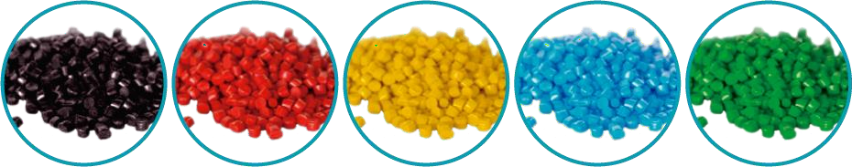
PREPARATION OF FILAMENT
FLAX
PLA
Figure 1.26 Pla Pellets of Colour
Figure 1.27Flax Pellets of Colour
PLA pellets can be used in the manufacture of filament for FDM 3D printers using Filastruder or any other filament extruder.
A pellet extruder can be used directly.
Place Flax seeds as shown in figure 5.2 has taken in to flat bottom pan.
Dry roast them by tossing continuously on medium high heat at 200C in oven till they become slightly puffed and begin to crackle.
It has been cool down using curing processs.

Slide 18
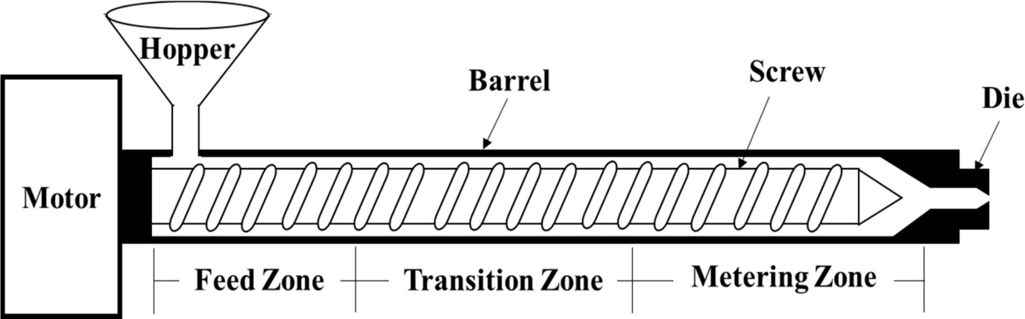
PREPARATION OF FILAMENT BY EXTRUDER PROCESS
Figure 1.28 Layout of Extruder Machine process

Slide 19
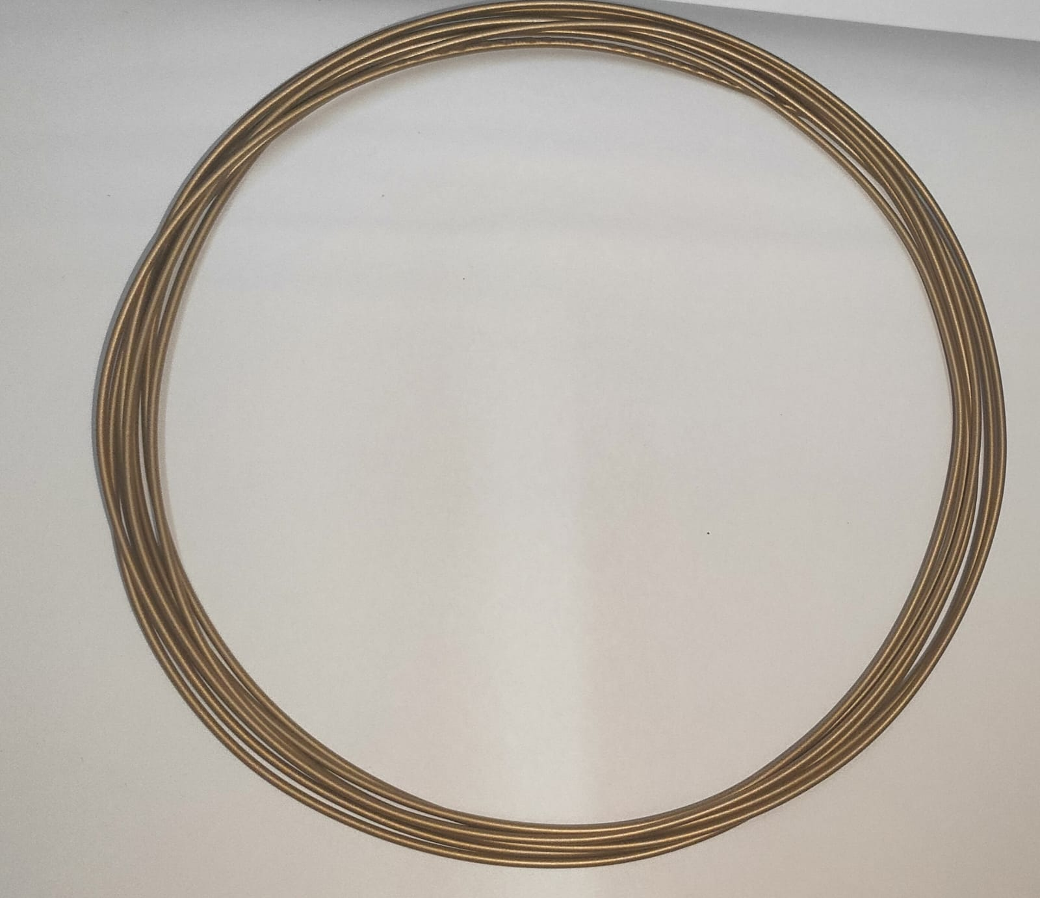

Slide 20
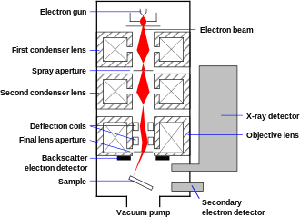
MICROSTRUCTURE TESTING
SCANNING ELECTRON MICRSCOPE
1.29 Process of Scanning Electron Microscope
The detailed three-dimensional and topographical imaging and the versatile information garnered from different detectors.
SEMs are also easy to operate with the proper training and advances in computer technology and associated software make operation user- friendly.

Slide 21
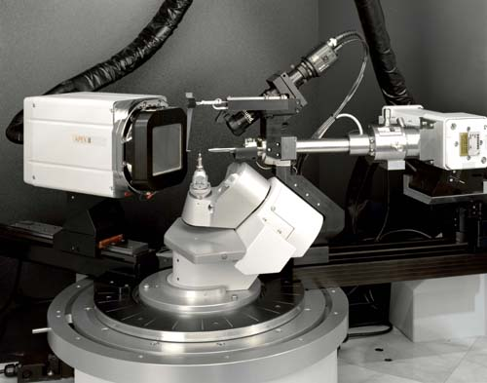
X-RAYDFIFFRACTION
Figure 1.30 X-RAY DIFFRACTION MACHINE
CATALYST EVALUATION
Reservoir core analysis
Fuel quality testing
New materials research and development
Polymers and Composites: Crystalline form, Crystallinity, Crystalline Perfection, Orientation

Slide 22
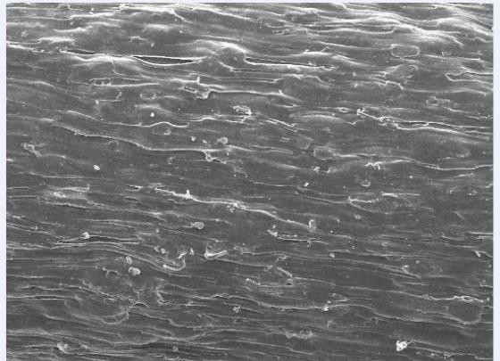
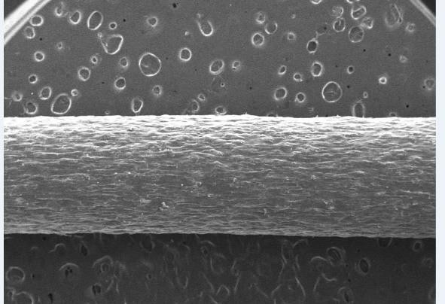
CONCLUSION
SEM TESTING
Figure 1.31 50micron SEM Images
Figure 1.32 100micron SEM Images
The sample image of the filament is tested on 50micron level. The surface image is round big figure so there is no deviation on the surfaces. Therefore the image is satisfied
The sample image of the filament is tested on 100micron level. The image of a sample looks flat surface so there is no any deviation on the surface. Therefore the image is satisfied

Slide 23
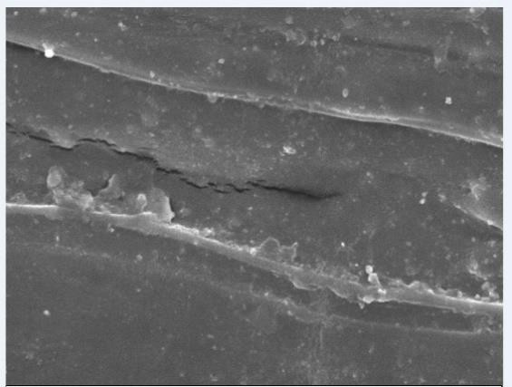
Figure 1.33 200micron SEM Images
The sample image of the filament is tested on 200 micron level. The image of a sample looks flat surface so there is no any deviation on the surface. Therefore the image is satisfied.

Slide 24
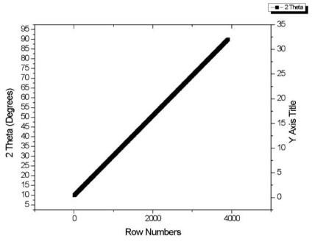
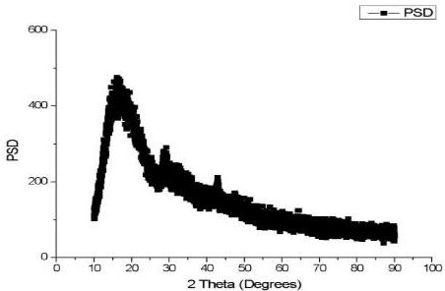
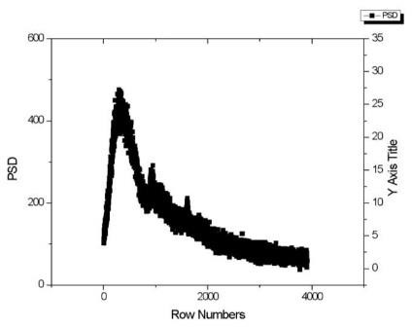
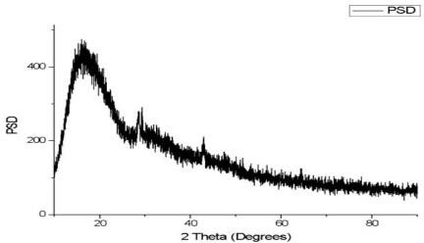
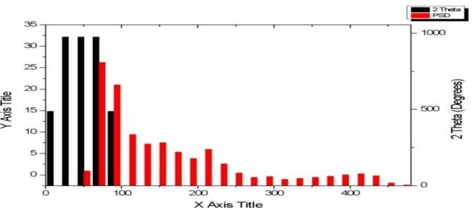
X-RAY DFIFFRACTION

Slide 25
REFERENCE
1. A Mantelli, A Romani, R Suriano, M Diani, M Colledani 2021. UV assisted 3D printing of polymer composites from thermally and mechanically recycled carbon fibers. MDPI, Polymers, Volume 13.
2. AD Valino, JRC Dizon, AH Espera Jr., Q chen 2019. Advances in 3D printing of thermoplastic polymer composites and nanocomposites. Elsevier, Progress in Polymer Science, Volume 98
3. AN Dickson, HM Abourayana, DP Dowling 2020. 3D printing of fiber reinforced thermoplastic composites using fused filament fabrication: A review. MDPI, Polymers, Volume 12.
4. D Yang, KWu, Y Sheng 2017. A particle element approach for modeling the 3D printing process of fiber reinforced polymer composites. MDPI, Journal of Manufacturing and Material Process, Volume 1.
5. Eda Hazal Tumer, Husnu Yildrim Erbil 29th Mar 2021. Extrusion based 3D printing application of PLA composites: A review. MDPI, Coatings, Volume 11.
6. Francis Dantas, Kevin Couling and Gregory J. Gibbons 2020. Long-fiber reinforced polymer composites by 3D printing: influence of nature of reinforcement and processing parameters on mechanical performance. SpringerOpen, Functional Composite Materials, Volume 7.

Slide 26
7. František Bárnik, Milan Vaško, Milan Sága, Marián Handrik, Alžbeta Sapietová 2018. Mechanical properties of structures produced by 3D printing from composite materials. EDP Sciences, MATEC web of conferences,Volume 254.
8 .Haoqi Zhang, Jiang Wu, Colin Robert, Conchur MO Bradaigh, Dongmin Yang 2022. 3D printing and epoxy infusion treatment of curved continuous carbon fiber reinforced dual polymer composites. Elsevier, Composites Part B : Engineering, Volume 234.
9. JP Lewicki, JN Rodriguez, C Zhu, MA Worsley 2017. 3D printing of meso- structurally ordered carbon fiber/ polymer composites with unprecedented orthotropic physical properties. Scientific Reports, Scientific Reports, Volume 7.
10. Katarzyna Bryll, Elżbieta Piesowicz, Paweł Szymański, Wojciech Ślączka and Marek Pijanowski 2018. Polymer Composite Manufacturing by FDM 3D Printing Technology. EDP Sciences, MATEC web of conferences, Volume 237.
11. LaythMohammed, M. N. M. Ansari, Grace Pua, Mohammad Jawaid, Saiful Islam 30th Aug 2015. A Review on Natural Fiber Reinforced Polymer Composite and Its Applications. Hindawi, International Journal of Polymer Sciences, Volume 2015.
12. Mario Piedrahita Bello, Jose Elias Cervera, Remi Courson, Gabor Molnar, Laurent Malaquin, Christophe Thibault, Bertrand Tondu, Lionel Salmon, Azzedine Bousseksou 2020. 4D printing with spin crossover polymer composites. Publishing, Journals of Material Chemistry C.

Slide 27
13. Masahito Ueda, Yuuki Watanabe, Yoichi Mukai, Nobuhisa Katsumata 2021. 3D printing of locally bendable short carbon fiber reinforced polymer
composites. Kingfa, Advanced Industrial and Engineering Polymer Research, Volume 4.
14. Mateusz Galeja, Aleksander Hejna, Paulina Kosmela 9th Jan 2020. Static and Dynamic mechanical properties of 3D printing ABS as a function of raster angle. MDPI, Materials, Volume 13.
15. M Invernizzi, G Natale, M Levi, S Turri, G Griffini 2016. UV assisted 3D printing of glass and carbon fiber reinforced dual cure polymer composites. MDPI, Materials, Volume 9.
16. M Liu, SW Chiang, X Chu, J Li, L Gan, Y He, B Li 2020. Polymer composites with enhanced thermal conductivity via oriented boron nitride and alumina hybrid fillers assisted by 3D printing. Elsevier, Ceramics International, Volume 46.
17. Morteza Ziaee, James W Johnson, Mostafa Yourdkhani 2022. 3D printing of short carbon fiber reinforced thermoset polymer composites via frontal polymerization. ACS Applied Materials & Interfaces, Volume 14.
18. Nisarg A. Patel, Jaydeep R. Shah, Shashank J. Thanki 2018. A Comprehensive Review on 3D Printer Composite Filament Used in Fused Deposition Modeling. IJCRT, Volume 6.

Slide 28
19. Sachini Wickramasinghe, Truong Do and Phuong Tran 10th July 2020. FDM based 3D printing of polymer and associated composite: A review on mechanical properties, defects and treatments. MDPI, Polymers, Volume 12.
20.Sayed Waqar Azhar, Fujun Xu, Yinnan Zhangand Yiping Qiu 2020 Apr. Fabrication and mechanical properties of flaxseed Fiber bundle-reinforced polybutylene succinate composites. SAGE Journals, Journal of Industrial Textiles, Volume 50
21. S Park, W Shou, L Makatura, W Matusik, KK Fu 2022. 3D printing of polymer composites : Materials, processes, and applications. ScienceDirect, Matter, Volume 5.
22. SC Daminabo, S Goel, SA Grammatiko, HY Nezhad, VK Thakur 2020. Fused deposition modeling- based additive manufacturing (3D printing) : Techniques for polymer materials. ScienceDirect, Materialstoday Chemistry, Volume 16.
23. Q.Sun, G.M.Rizvi, C.T. Bellehumeur, P.Gu 11th Oct 2007. Effect of processing conditions on the bonding quality of FDM polymer filaments. Emerald Insight, Rapid Prototyping Journal, Volume 14.
24. Nishata Royan Rajendran royan, Jie Sheng Leong, Wai Nam Chan, Jie Ren Tan, Zianon Sharmila Binti Shamsuddin 2021. Current state and challenges of natural fiber reinforced polymer composites as feeder in FDM based 3D printing. MDPI, Polymers, Volume 13.

Slide 29
25. S Singamneni, D Smith, MJ LeGeun, D Truong 2018. Extrusion 3D printing of polybutyrate-adipate-terephthalate polymer composites in the pellet form. MDPI, Polymers, Volume 10.
26. Seyed Hamid Reza Sanei, Diana Popescu 24th July 2020. 3D printed carbon fiber reinforced composites: A systematic review. MDPI, Journal of Composites Science, Volume 4.
27. TNAT Rahim, AM Abdullah, H Md Akhil 2019. Recent Developments in fused deposition Modeling- based 3D printing of polymers and their composites. Taylor and Francis Online, Polymer Reviews, Volume 59.
28. Ümit Çevik and Menderes Kam 21st Nov 2020. A Review Study on Mechanical Properties of Obtained Products by FDM Method and Metal/Polymer Composite Filament Production. Hindawi, Journal of Nanomaterials, Volume 2020.
29. Vahid Monfared, Hamid Reza Bakhsheshi, Seeram Ramakrishna, Mahmood Razzaghi and Filippo Berto 16th June 2021. A Brief Review on Additive Manufacturing of Polymeric Composites and Nanocomposites. MDPI, Micromachines, Volume 12.
30. Xin Wang, Man Jiang, Zuowan Zhou, Jihua Gou, David Hui 2016. 3D Printing of polymer matrix composites: A review and prospective. Research Gate, Composites Part B: Engineering, Volume 110.
31. X Wang, M Wang, M Jiang, Z Zhou, D Hui 2017. 3D printing of polymer matrix composites: A review and prospective. ELSEVIER, Composites Part B: Engineering, Volume 110.

